Slide 1
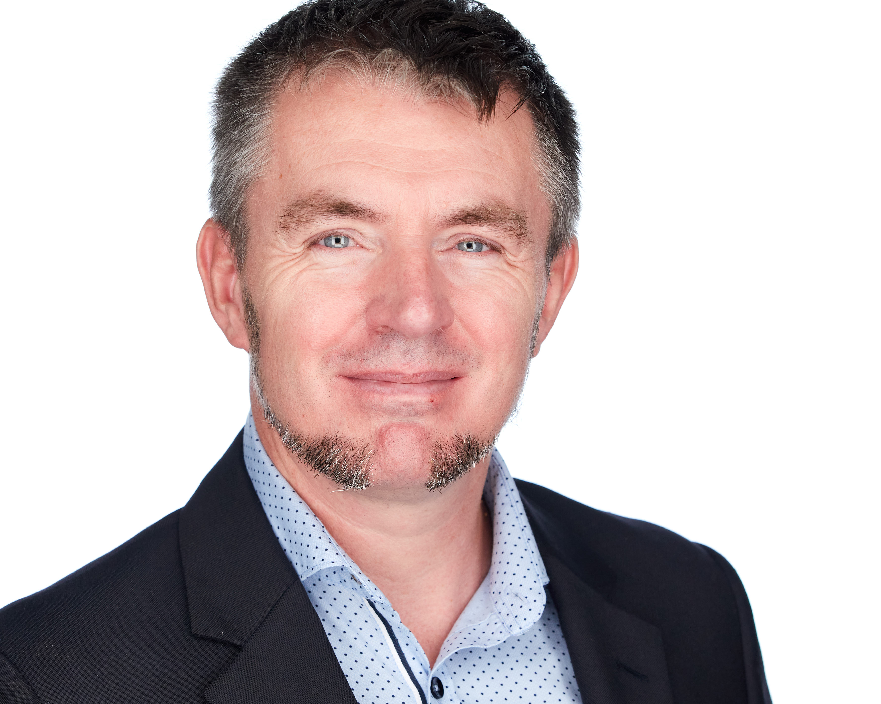





JON-PAUL BOYD
Intelligent Systems Engineer
I thrive on delivering tangible, cutting-edge, AI-enabled and analytic solutions that inform, empower & perform. I help solve business challenges and deliver value to all stakeholders through strong theory, practical hands-on, clarity of thought and communication.
+41 (0)79 952 18 81 jp@corticalstack.ai corticalstack.ai jonpaulboyd Nyon, CH
CAREER HIGHLIGHTS
EDUCATION
STATS
SAP HANA Technical Architect
Nestle | Vevey, CH | 2014 – 2017
Technical lead, inspiring team implementing groundbreaking first HANA-based analytic reporting solution for 3000 users.
Led 5 HANA major upgrades & migration of analytics sidecar to embedded NetWeaver/HANA dual stack.
Extensive XSC/XSA development with database modelling, Fiori, SQLScript, XSJS, Node.js, security, optimisation.
Developed automated tool for analytic privileges build & assign, performance tool measuring query runtimes vs KPIs.
Configured HANA workload management, HALM, HRF. Major contributor to Nestle HANA Development best practices.
Daily liaison with Nestle & SAP partners, presentation to management, key users, technical and product teams.
Learned I’m still hungry for technical challenges.
SAP HANA Technical Architect
Bluefin Solutions | London, UK | 2014
Helped BAT realise Gartner’s Logical Data Warehouse concept by implementing HANA SDA for data federation of London & Sydney databases.
Developed P&L with sub-second performance (legacy 2m10s), SAP Fiori KPI dashboard with line item drill-down.
Learned trust won on transparency & keeping delivery promises goes a long way.
SAP HANA Technical Architect
HANA Propulsion Laboratory| Blonay, CH | 2013
Engineered remote piloted vehicle with real time telemetry to Cloud-hosted HANA database for analytics & real time vehicle control via openUI5 browser cockpit.
Data mining for game analytics &achievement/reward system tied to mission objectives & pilot behaviour.
Learned benefits of deep and wide research.
SAP Web Dynpro ABAP Consultant
Nestle| Vevey, CH | 2010 – 2013
Lead developer for complex development & problem-solving, delivered technical training for offshore teams.
Brought sophisticated recipe change doc concept to life with UI design driven by simplicity, familiarity & customisation.
Learned greater self-belief & improved interpersonal skills through learning from others.
SAP ABAP Consultant
Belgian Railways| Brussels, BB | 2008 – 2010
With a natural team-lead expertise successfully delivered a warehouse management shipment handling project.
Individually responsible for complex bespoke development functionality within logistics execution.
Learned love of OO dev & software in physical systems.
SAP ABAP Consultant
Cap Gemini| Middlesbrough, UK | 2000 – 2008
Senior ABAP dev in SAP competency centre, responsible for on-going support, dev & upgrades for several clients.
Analysed customer SAP systems from ABAP perspective to enable the smooth transitioning to SAPrun support.
Delivered revenue earning on-site consultancy/training.
Work pipeline management and assignment, training and support of 3 ABAP developer colleagues.
Innovated systems integration monitoring dashboard.
Learned rewards of coaching juniors.
Masters Intelligent Systems
De Montfort University | UK | 2017 – 2020
Discovered why stronger partnerships should exist between enterprise and academia.
Applied Computational Intelligence (88%) Predicting customer behaviour with tree-based classifiers. Extensive Python with data profiling & preparation, unsupervised & supervised machine learning, overfitting protection, hyperparameter tuning, model scoring, evaluation & selection.
A.I. Programming (80%)
NLP Python NLTK context-free grammars for natural language to SQL database query.
Data Mining (80%)
Data analysis & machine learning to predict risk indicators for cardiovascular disease.
Neural Networks (80%)
Evaluation of biomass & classification of network activity (intrusion, attack, normal).
Fuzzy Logic (94%)
Classifying breast cancer tumours with fuzzy inference system, outperforming neural networks. Paper being submitted to journal of Applied Soft Computing for publication.
Research Methods (96%)
PhD proposal for augmented analytics.
Mobile Robots (97%)
Virtual search & rescue robot controlled via Python, implementing obstacle avoidance, sensor data fusion, environment mapping, precision navigation, victim location.
Computational Intelligence Optimization (100%) Design & build of Python-based hyper-heuristic optimization platform to address the real-world problem of scheduling optimisation. 5 example nature-inspired metaheuristic algorithms are implemented. A hyper-heuristic feature dynamically switches between low-level metaheuristics to deterministically use the most appropriate algorithm according to current problem state, or select one stochastically.
Masters Project In Progress
Building cloud-hosted medical research cockpit for knowledge discovery, summarization, topic classification & clustering for best-informed next stage research actions, using COVID-19 literature.
23
LinkedIn Recommendations
25
Years software dev
5
Years HANA dev
36
Companies provided expertise
35
GitHub Repos
8
Masters modules graded distinction
12
Times consulting contract extended
1
Individual delivering client centric excellence
TOOLS
Python
Pandas
Numpy
Scikit-Learn
Keras
NLTK
Elasticsearch MongoDB
SAP HANA
SAP ABAP
SAP Security
ReactJS
JavaScript
Amazon AWS
MS Azure
Docker
Git
GitLab
Linux
Windows 10
PRAISE
“Tech savvy, experienced, meticulous, dependable, ingenious & eager to learn more”
Rudi Dutli, Principal, Infosys Lodestone
“Builds comprehensive understanding of architectures involved, educating & inspiring teams & co-workers in the process. A real flair for challenging, on-the-edge development”
Trond Stroemme, Team Lead, SAP App Expertise Centre, Nestle
“An expert in his domain, a great team player. His focus on results with optimal quality is outstanding”
Norbert Rignall, Master Data Solution Architect, Nestle
AWARDS
Microsoft Certified Azure Fundamentals
AWS Certified Cloud Practitioner

